Slide 1
Extraction of data
Team Members:
G.Satya Priya Chowdary (14B21A0567)
T.Lakshmi Narayanama (14B21A0563)
R.Sai Kumar (14B21A0564)
P.Ram Nikhil (14B21A05B3)
V.Praveen (15B25A0525)
under the guidance of
Vijay Kumar .K -B.tech,M.tech,(Ph.D).
CSE Department

Slide 2
ABSTRACT
Globally there is a huge amount of data given by the users in the world, Therefore we started to collect the required data from some social networking sites like twitter. This is mainly used in Business analytics for gathering Information about a particular topic and much more. It is one of the basic methodology in data mining.

Slide 3
Existing system
Limited number of data will be extracted from the social networking sites(twitter).
The Data will be extracted only in English language
Previously only data can be extracted.
.

Slide 4
System analyser
It is a Data Mining
For example,
If global companies like Apple, Google etc, when there new products are launched there need user feed back and there can’t go ask each one in personal using our method we can get the data form twitter when user posts tweet like : “camera is perfect #pixel2”

Slide 5
Continued..
In Extracting of data we can get in multiple tweets at a time.
Languages can be changed into global languages around the world.
Collectively, we will call this a ‘Extracting’
The process of defining the architecture, components, modules, interfaces and data to satisfy the required end users.

Slide 6
CONTINUED:
System
Design
Plan
Coding
Debug/
Deployment
Testing

Slide 7
Methodology:
Code
Packages
Authentication
Twitter api
Consumer keys
Data
Output
Tweets extracted
Language

Slide 8
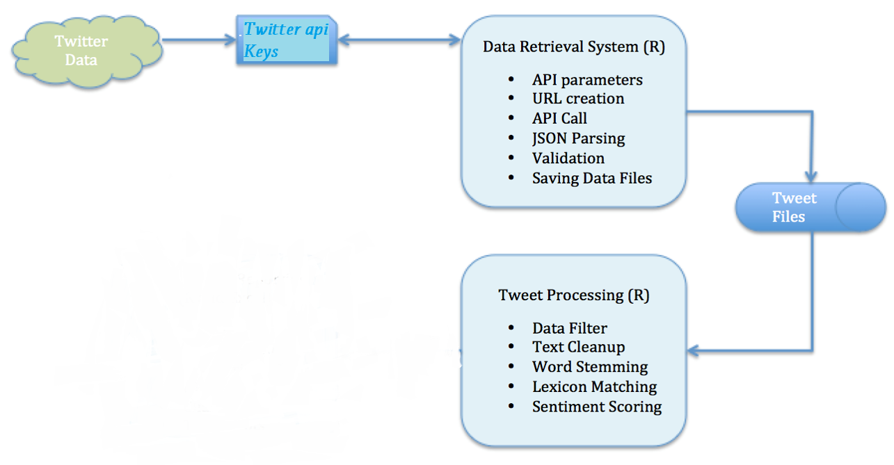
Continued:

Slide 9
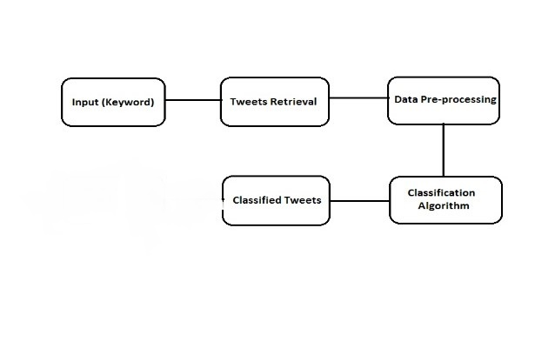
System Design:

Slide 10
Testing:
We have tested in all cases and got the accurate results.
We have tried in global languages and got the result for it also

Slide 11
Conclusion
Therefore the required output has been obtained for the extraction of data
We are tried in global languages and we have got the result.

Slide 12
Thank You

